Slide 1

Policy Dispensations & Security Risk Approvals Requirements and Process v1.2
Sanet Butler (reviewed by Richard Norris)
Vodacom Group Cyber Security
November 2021

Slide 2

Introduction
The aim of this document is to clarify the requirements and process for Vodacom Group markets for Technology Security:
Vodacom Policy Dispensations (PD)
Vodafone Security Risk Approval (SRA)
This document is an abbreviated version of the Vodafone Cyber GRC documents, and the processes are specific to Vodacom markets.
These processes are identical to the VF Group GRC processes, except for one additional step prior to VF Security Risk Approval (SRA) submissions, and the incorporation of Policy Dispensation (PD) processes for managing Vodacom local market Cyber risk.
Clarification of the updated VF Group Risk Management Framework is provided on slide 4.
All related Vodafone Cyber Risk Management documentation can be accessed here:
https://vodafone.sharepoint.com/sites/groupsecuritypolicies/Pages/Policy-Details.aspx?Policy=Security%20Risk%20Framework

Slide 3
One-Pager Overview
Vulnerabilities
Emergency vulnerability
Everything Else
High Risk
Vodafone SRA
Critical vulnerability
Vodafone SRA – Regardless of the Risk rating
All risk levels – If across multiple markets
High – External Facing
Low/Medium Risk that will take longer than 30 days to resolve – Single market
Local Market PD
High – Internal Facing
Local Market PD
Medium/Low vulnerability
CSANs
Vodafone SRA – Regardless of the Risk rating

Slide 4
VF Group
Cyber Risk Management Framework (new 2021)

Slide 5
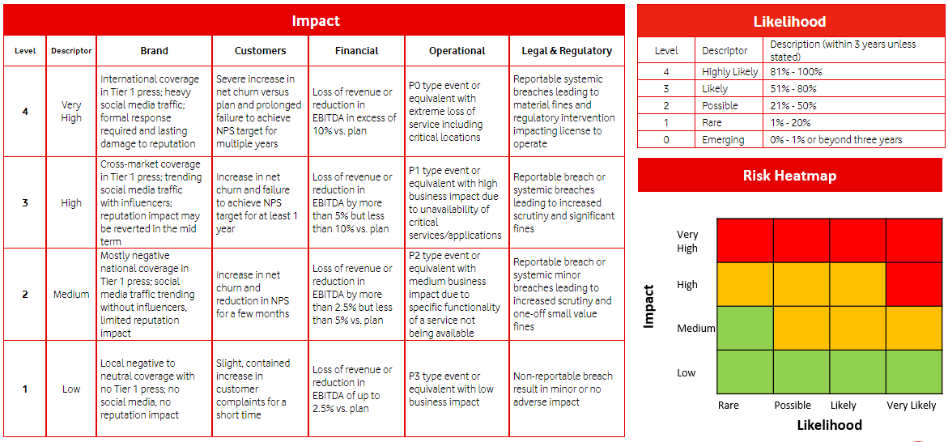
Vodafone Group Risk Management Framework
Risks are classified only as Low, Medium and High. In the Heatmap below, green is Low, orange is Medium, and red is High.
Do not confuse the overall risk rating with the Impact and Likelihood ratings.
Removed

Slide 6
Security Risk Approval (SRA) or Policy Dispensations (PDs) are required when:
Introducing or discovering a Cyber risk which is rated Medium or High.
Cyber risk is introduced by a new product, service or project
A new supplier Cyber risk is identified
Risk is discovered through a Cyber security incident
Vulnerabilities are identified which are not/cannot be mitigated or removed within defined timelines:
7 days for Emergency and Critical vulnerabilities
30 days for High vulnerabilities
60 days for Medium vulnerabilities
CSANs may have different SLAs which will be communicated
Refer to Slide 14 & 15 for handling of Technical Vulnerabilities and CSANs.
The established timeline for mitigation of a Cyber security vulnerability or issue has expired, or the risk approval has expired.
A system (hardware, software, application, database, code) is not compliant with Technology Security (Cyber Security) policies, detailed requirements, and standards

Slide 7
Risk Submission and Assessment Responsibilities (1)
RESPONSIBLE
for raising risk
ACCOUNTABLE
The Risk Owner
CONSULTED for risk management approval
INFORMED
LOW Risk
Single Market
Local personnel, or Cyber specialist, discusses with local Cyber management (EHOD)
Local F-band (EHOD) with suitable knowledge and authority to address the risk.
Local Cyber Risk Management (GRC)
Risk Owners and Stakeholders
LOW Risk
Multiple Markets
Local personnel, or Cyber specialist, discusses with local Cyber management (EHOD).
Raise SRA to VC Global GRC, who submits to VF Global GRC.
Local F-band (EHOD) with suitable knowledge and authority to address the risk.
Local Cyber GRC, who raises SRA with VC Group GRC.
VC Group GRC, who submits SRA to VF Group GRC.
Risk Owners and Stakeholders, also Stakeholders who may be outside the business area of the submitting Cyber team.
MEDIUM Risk
Single Market
Local personnel, or Cyber specialist, discusses with local Cyber management (EHOD)
Local E-band (ME) with suitable knowledge and authority to address the risk.
Local Cyber Risk Management (GRC)
Risk Owners and Stakeholders
MEDIUM Risk
Multiple Markets
Local personnel, or Cyber specialist, discusses with local Cyber management (EHOD).
Raise SRA to VC Global GRC, who submits to VF Global GRC.
Local E-band (ME) with suitable knowledge and authority to address the risk.
Local Cyber GRC, who raises SRA with VC Group GRC.
VC Group GRC, who submits SRA to VF Group GRC.
Risk Owners and Stakeholders, also Stakeholders who may be outside the business area of the submitting Cyber team.
HIGH Risk
Local personnel, or Cyber specialist, submitted to VC Global Cyber GRC, to discuss with Cyber ME and VC Group CTO.
VC Group CTO
VC Group Cyber GRC to submit SRA to VF Cyber GRC, as received from LM or multiple LMs.
VF Cyber GRC to discuss with
VF Global Cyber Security Director or VF Group CTO.

Slide 8
Vodacom Group Cyber Security
Cyber Risk Management Process

Slide 9
What is a Policy Dispensation?
A Policy Dispensation is not a mechanism to avoid following Cyber Security Policies, Detailed Requirements or Standards.
A Policy Dispensation:
Is a temporary, time-limited, formal approval to deviate from a Cyber Security policy due to unforeseen circumstances, or situations where a security fix cannot immediately be applied.
Must be fully risk assessed by Cyber Security prior to business acknowledgement and risk acceptance
Must be provided with – or already have – sufficient mitigating controls on the asset(s) and/or operating environment in scope to minimize the risk
Must have a time-based remediation plan to recover from the risk
Some examples of situations where a PD will be considered:
A vulnerability is identified for which a patch or fix is not available from the vendor within the vulnerability SLA remediation timeline.
A non-secure protocol is in use which cannot be upgraded in the short-term due to infrastructure/environmental complexity, dependencies and/or cost
A system is not compatible with a security tool, and an alternative or work-around is being investigated

Slide 10
Technology End of Support / End of Life Risks
Technology End of Life (EOL) is not a deviation from a Cyber Security policy, it is a deviation from an IT policy.
For an EOL-related vulnerability or issue, the Local Market must first obtain a Risk Acceptance or PD for EOL from IT or Networks. Thereafter a Cyber Security PD/SRA can be raised for the vulnerability or issue.
Raise a Risk Acceptance with Enterprise/Corporate Risk (if EOL cannot be decommissioned/upgraded in the short term) OR submit a PD to IT/Networks if the EOL systems can be decommissioned/upgraded in the short term – 6 months or less)
Obtain approval for the above from Business
Submit a Cyber Security PD or SRA for the associated vulnerabilities or issues (e.g. cannot install Anti-malware, cannot upgrade legacy protocols, etc.)

Slide 11
Risk Process Workflow – Not for Vulnerabilities or CSANs
Refer to Page 14 and 15 for managing Technical Vulnerability risks and CSANs
Cyber Risk Identified
Requestor from Business completes a Policy Dispensation (PD)
PD remediation and mitigation is tracked by Cyber GRC until resolved.
For the following:
All HIGH Risks
Low/Medium risks that will take longer than 30 days to resolve
Local Cyber GRC performs a Risk Assessment on PD
Local PD process continues as normal with EHOD and ME approvals.
Low/Medium Risk
Single Local Market /
Single Global Entity
High Risk
What Business does the Risk affect?
Multiple Local Markets /
Multiple Group Entities
Low/Medium/High Risk
and CSANs
VC Group Cyber GRC submits to VF Global Cyber Risk.
Risk is tracked to conclusion (both on VF Group and LM level)
Send SRA to Vodacom Group GRC for final review, and included in VC Group Risk Register.
Notify VC Group Cyber ME.
Report to VC Group RMC and ARCC.
Complete an SRA
(Requestor, reviewed by local Cyber GRC, signed by local Head of Cyber Security)
LM Cyber GRC to document risk.

Slide 12
Risk Submission and Assessment Responsibilities (2)
Issues that may require discussion with the VC Group Cyber GRC or VF Cyber GRC teams (not limited to the below list):
There is a significant business requirement to go live with a new or changed/updated product, solution or system in a time-frame that does not give an opportunity for an effective risk assessment or mitigation actions.
Specialist Cyber Security GRC staff are not available within a local market.
It is not immediately obvious who the Risk Owner or Action Owner is.
The risk is across multiple local market business units.
In the above and similar circumstances, the Group GRC teams can provide guidance.
The Vodafone Cyber Risk Framework and SRA Template with guidance can be accessed from the below link:
https://vodafone.sharepoint.com/sites/groupsecuritypolicies/Pages/Policy-Details.aspx?Policy=Security%20Risk%20Framework

Slide 13
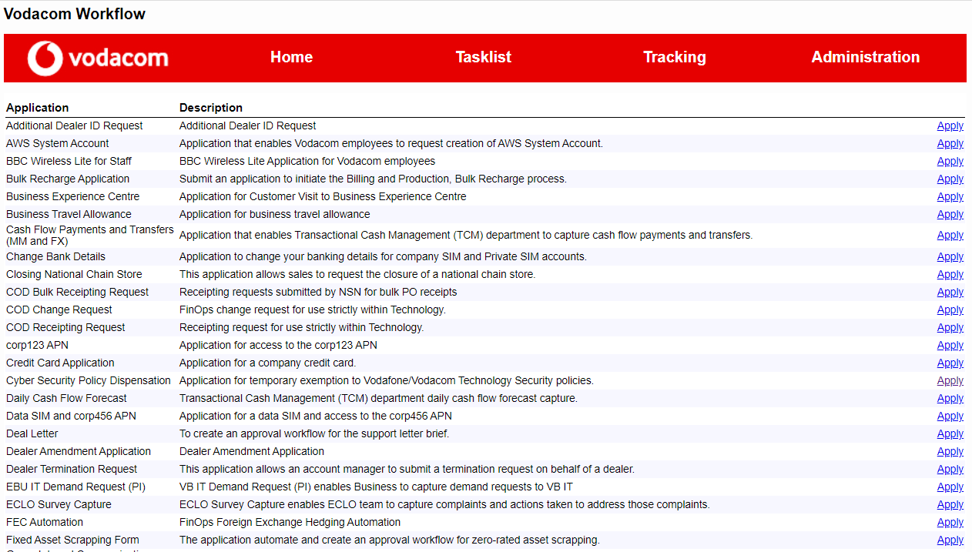
Automated and Manual Policy Dispensations (PDs)
The Vodacom Cyber Security Policy Dispensation workflow can be accessed from the below link:
https://workflow.vodacom.corp (see screenshot below)
Alternatively, the associated Word document for offline PDs is here. The latest document version is 2.2

Slide 14
Vodacom Group Cyber Security
Technical Vulnerability and CSAN Risk Management Process

Slide 15
Emergency, Critical and High Technical Vulnerabilities
For Vodacom markets:
A local market Policy Dispensation is required for all technical vulnerabilities which cannot be remediated within SLA
Low, Medium and Internal-facing High technical vulnerabilities are tracked and managed on local market level by the local Cyber GRC team
For Emergency, Critical and External-facing High vulnerabilities :
for which there is no possible fix except retiring, decommissioning, or replacing the asset(s) OR
when the cost of fixing the asset(s) is greater than the potential impact if the vulnerability is exploited
an SRA is required. This SRA must :
be completed by the local market,
the risk assessed by the local Cyber GRC team, and
the SRA submitted to Vodacom Group GRC for validation. VC Group GRC will discuss with and submit to VF Cyber GRC

Slide 16
General Vulnerability Workflow (excl. CSANs)
High Vulnerability
Emergency / Critical Vulnerability
SRA not required.
Manage through local PD process if fix will take longer than SLA.
YES
NO
Is the vulnerability Internet-facing?
YES
Is a fix possible?
YES
Is a fix possible?
Low/Medium Vulnerabilities
NO, or too expensive or difficult to fix
NO, or too expensive or difficult to fix
Implement compensating controls
Implement compensating controls
Perform a risk assessment with local market Cyber GRC team.
Use SRA form
Submit SRA to Vodacom Group Cyber GRC for validation and submission to Vodafone Cyber GRC.
This is for all levels of risk (low, medium and high)
Perform a risk assessment with local market Cyber GRC team.
Use SRA form
Head of Cyber signs SRA
Business Owner accepts risk (sign SRA)
Head of Cyber signs SRA
Business Owner accepts risk (sign SRA)

Slide 17
CSAN Workflow
This is for all CSAN vulnerability levels
Perform a risk assessment with local market Cyber GRC team.
Use latest SRA form available here
Submit SRA to Vodacom Group Cyber GRC for validation of risk and content.
This is for all risk levels (low, medium and high)
Head of LM Cyber Security acknowledges SRA (signs)
LM Business Owner accepts risk (sign SRA)
As well as:
If risk is rated as:
Low: F-band acceptance
Medium: E-band acceptance
High: Director acceptance (CEO)
Vodafone Group Cyber GRC confirms receipt of SRA and agreement on risk level.
Provide signed SRA to Vodacom Group Cyber GRC for submission to Vodafone Group Cyber GRC

Slide 18
Vodacom Group Cyber Security
Process for IT/Technology Teams to follow for EOL Dispensations

Slide 19
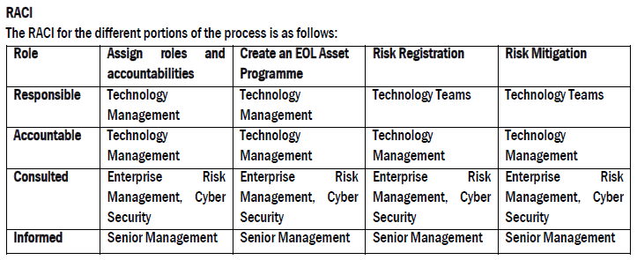
End-of-Life / End-of-Support Process
EOL is not a Cyber Security responsibility or breach of a Cyber policy. It is a Technology/Network Lifecycle Management policy breach, and as such, EOL dispensations need to be registered with Enterprise Risk by the relevant Technology/Networks team.
Only once the above has been done will a Cyber dispensation be considered for the related vulnerabilities, inability to patch or remediate non-secure protocols. These vulnerabilities need to remain open until a EOL risk has been logged with Enterprise Risk.
This was formally communicated by the Chief Risk and Compliance Officer and approved by the Group CIO and Group ME Cyber Security.

Slide 20
Vodacom Group Cyber Security
GRC and CSAN Contact List

Slide 21
Cyber GRC and CSAN Contact List
Vodacom Group Cyber GRC
Sanet Butler sanet.butler@vodacom.co.za
Tumi Tsotetsi keitumetsi.tsotetsi@vodacom.co.za
DRC Cyber GRC
Irene Njoroge Irene.njoroge@Vodacom.cd
Ghana Cyber GRC
Johnson Tamakloe johnson.tamakloe@vodafone.com
Kenya (Safaricom) Cyber GRC
Pharace Moraa Nyang’au PNyangau@Safaricom.co.ke
Lesotho Cyber GRC
Mookho Hlaahla mookho.hlaahla@vodacom.co.ls
Mozambique Cyber GRC
Mario Honwana mario.honwana@vm.co.mz
South Africa Cyber GRC
Deshan Pillay deshan.pillay@vodacom.co.za
Lwazi Hlazo lwazi.hlazo@vodacom.co.za
Tanzania Cyber GRC
MacBethana Wilfred wilfredm@vodacom.co.tz

Slide 22
End of Document

